Slide 1

MARKET
NAME:- Akhil Ankol
IT-1
160410116005

Slide 2
What is The market Structure?
In a layman’s language: Market is a specific place where goods and services are purchased and sold
Ex. Vegetable market
Those characteristics of the market that significantly affect the behavior and interaction of buyers and sellers.

Slide 3
Elements Of Markets
Nature of products
Existing of competition
Free communication
The place
Government policies

Slide 4
Types Of Market
1.perfect Competition
2.Monopoly
3.Monopolistic Competition
4.Oligopoly

Slide 5
Perfect Competition
Large no of buyers and sellers
Many and small sellers, so that no one can affect the market
Homogeneous product
Free entry to and exit from the industry
Transparent and free information
Ex: Agricultural market, street market

Slide 6
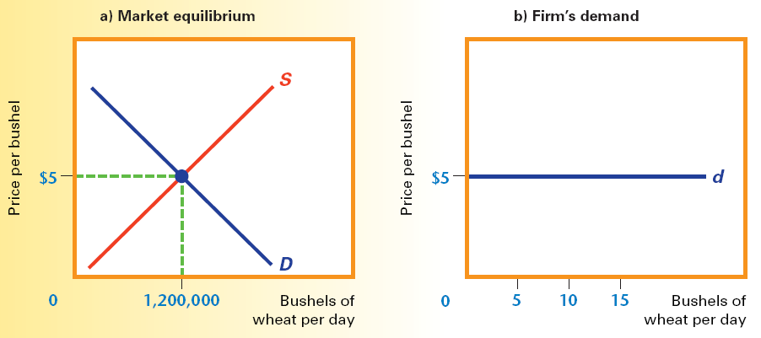
Curves in Perfect Competition
(Industry:– Price maker)
(Firm:-Price takes)
E

Slide 7
Monopoly
A single seller: the firm and industry are synonymous.
Unique product: no close substitutes for the firm’s product.
The firm is the price maker: the firm has considerable control over the price because it can control the quantity supplied.
Entry or exit is blocked.
Ex: Indian railways, state electricity board

Slide 8
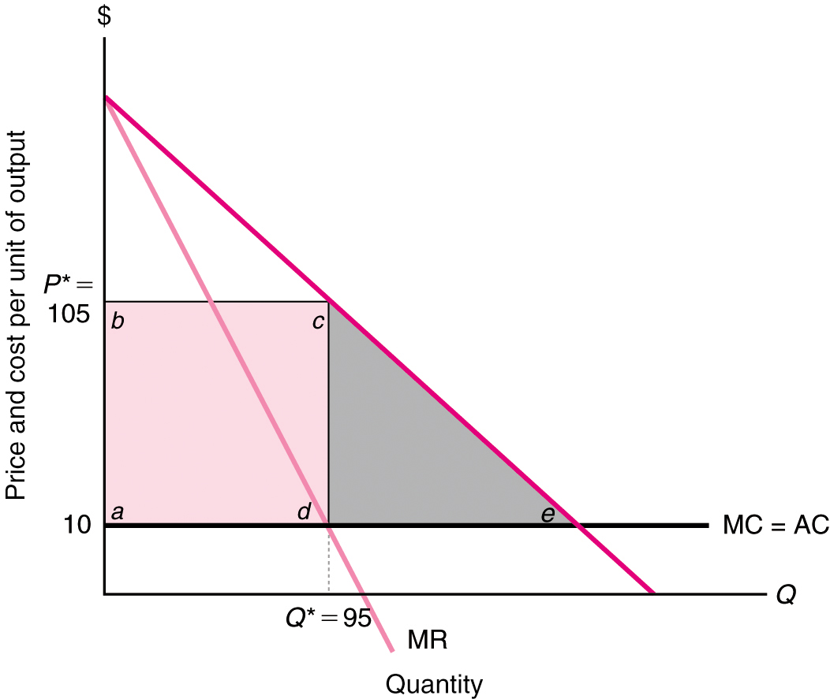
Curve in Monopoly
AC:-Average Cost
MC:-Marginal Cost

Slide 9
Monopolistic Competition
Large number of buyers and large number of suppliers with limited monopoly power.
Multiple firms produce similar products
Firms face down sloping demand curves
Profit maximization occurs where MC=MR
In the limit, firms compete away economic profits
Ex: clothing shops, gas station, home applied store

Slide 10
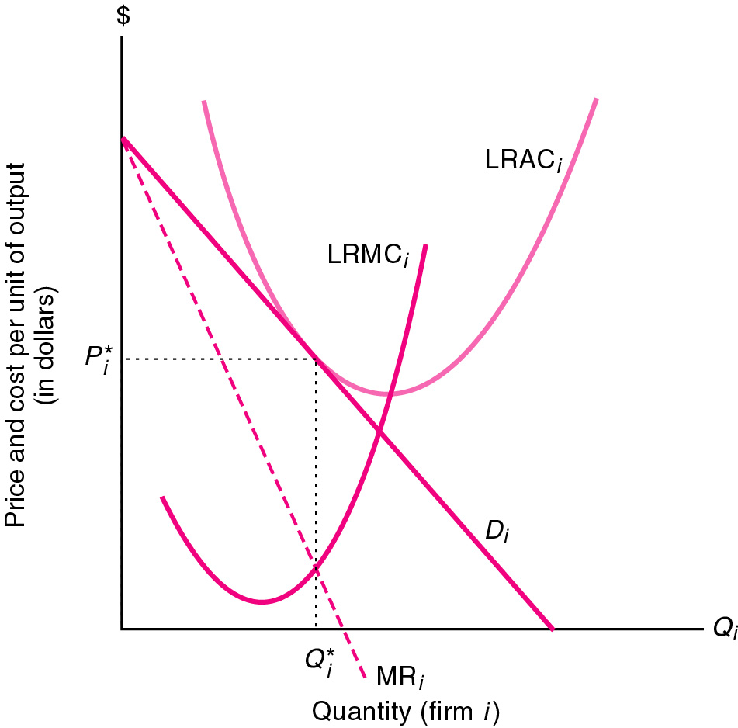
Curve in Monopolistic Competition

Slide 11
Oligopoly
Few large firms: each must consider its rivals’ reactions in response to its decisions about prices, output, and advertising.
Standardized or differentiated products
Entry is hard: economies of scale, huge capital investment may be the barriers to enter.
Ex: steel, oil, automobiles

Slide 12
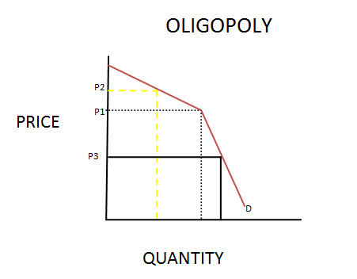
Curve in Oligopoly Competition

Slide 13


